Slide 1

Project 8
Unsupervised Learning
Uber dataset
Group 5:
Yanis Benneouala – Paul Melin

Slide 2

Approach & Methodology
Dataset : Uber trips in New York from August 2014
More then 800k rows
Goal is to find the optimal number of clusters to provide recommendations on where drivers should be to maximize their chances of finding a ride
Find the optimal number of cluster using elbow method
Methods used:
Kmeans
DBSCAN
Agglomerativeclustering
Compare the models
Visualize the cluster data on a map using folium library
Elbow method

Slide 3
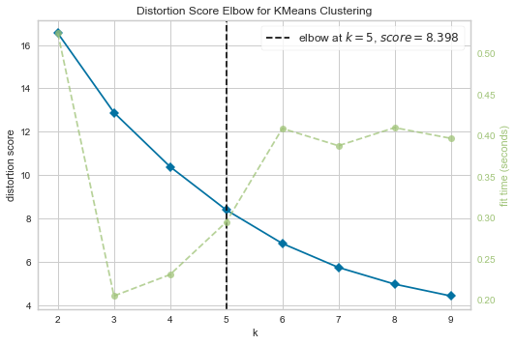
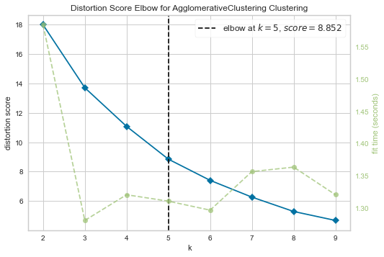
Optimize number of clusters
Ideal number of clusters for Kmeans seems to be 5
Ideal number of clusters for Agglomerativ clustering also seems to be 5

Slide 4
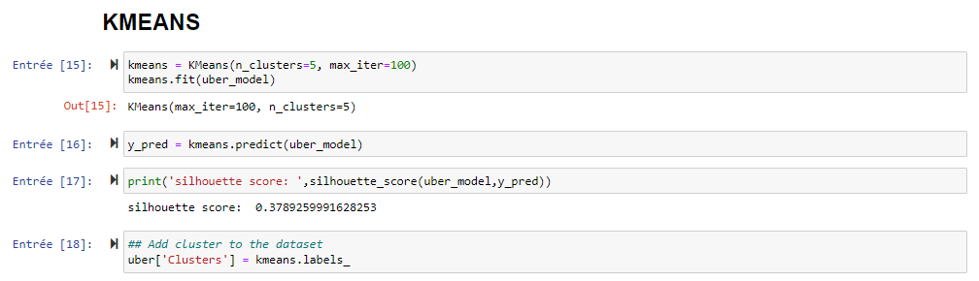
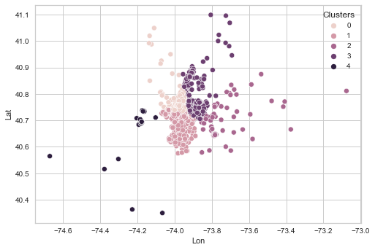
Kmeans Model
The KMeans algorithm clusters data by trying to separate samples in n groups of equal variance, minimizing a criterion known as the inertia or within-cluster sum-of-squares (see below). This algorithm requires the number of clusters to be specified. It scales well to large number of samples and has been used across a large range of application areas in many different fields.
Silhouette score = 0.38
The Kmeans algorithm clusters data by trying to separate samples in n groups of equal variance, minimizing a criterion known as the inertia or within-cluster sum-of-squares (see below).
This algorithm requires the number of clusters to be specified. It scales well to large number of samples and has been used across a large range of application areas in many different fields.

Slide 5
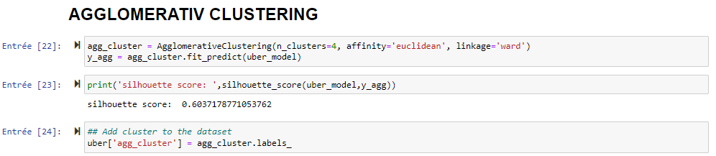
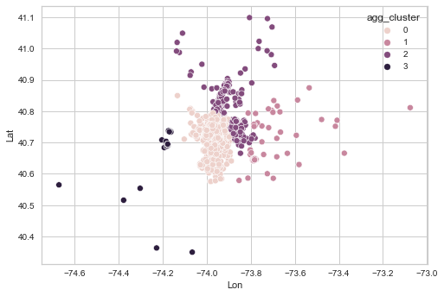
Agglomerativ clustering
Silhouette score = 0.60
Hierarchical clustering is a general family of clustering algorithms that build nested clusters by merging or splitting them successively.
This hierarchy of clusters is represented as a tree (or dendrogram). The root of the tree is the unique cluster that gathers all the samples, the leaves being the clusters with only one sample.
The AgglomerativeClustering object performs a hierarchical clustering using a bottom up approach: each observation starts in its own cluster, and clusters are successively merged together.

Slide 6
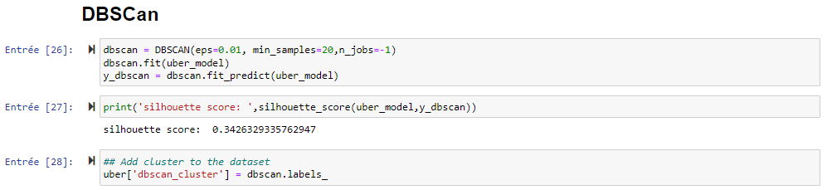
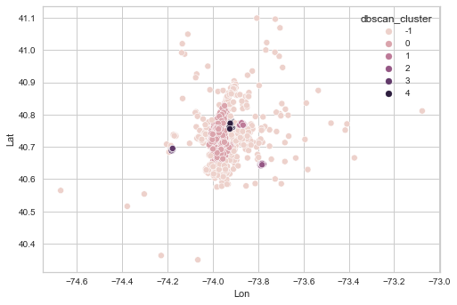
DBSCan
Silhouette score = 0.34
The DBSCAN algorithm views clusters as areas of high density separated by areas of low density. Due to this rather generic view, clusters found by DBSCAN can be any shape, as opposed to k-means which assumes that clusters are convex shaped. The central component to the DBSCAN is the concept of core samples, which are samples that are in areas of high density.

Slide 7
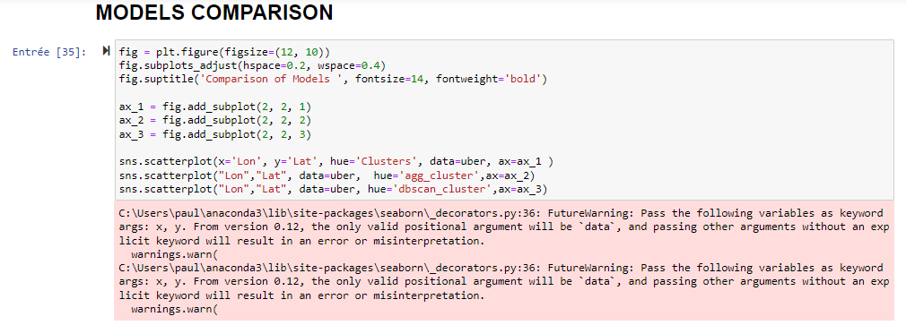
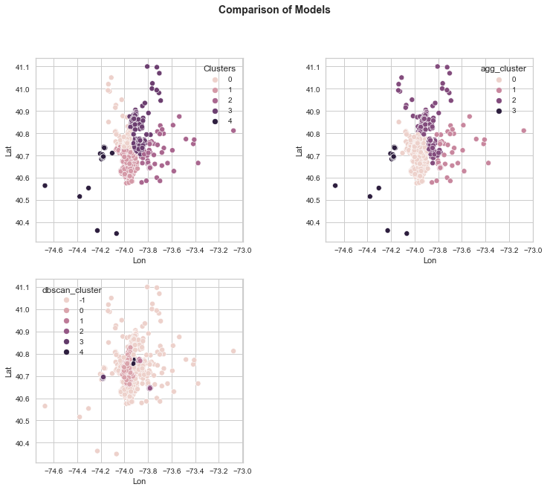
Models Comparison
Model | Silhouette score
Kmeans | 0.38
Agglomerativ clustering | 0.60
DBSCan | 0.34

Slide 8
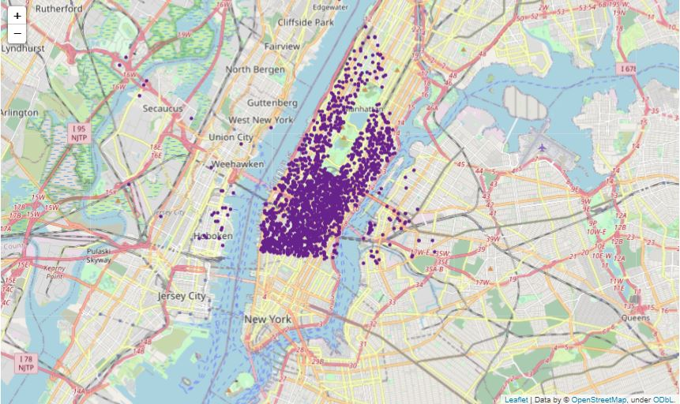
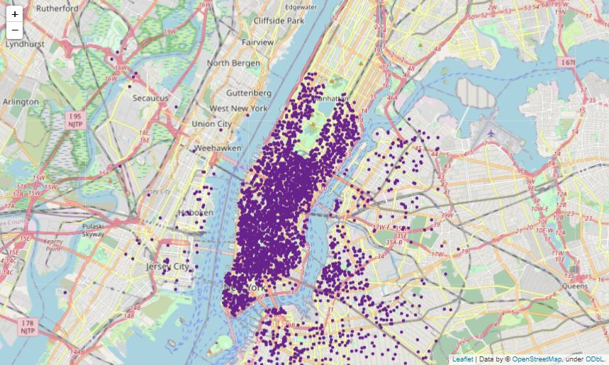
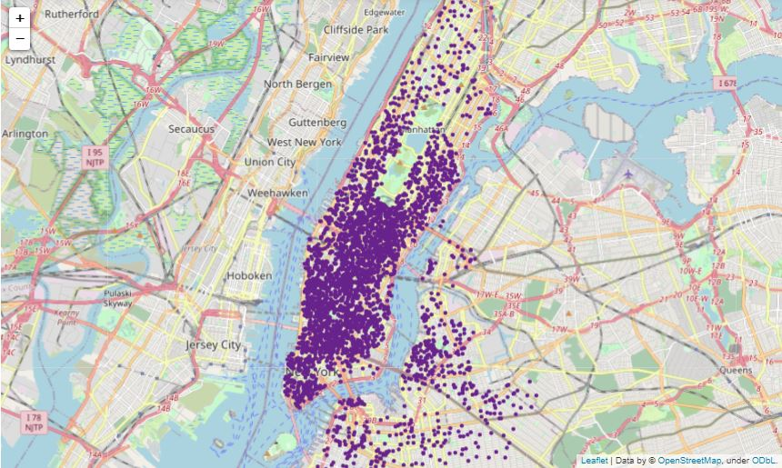
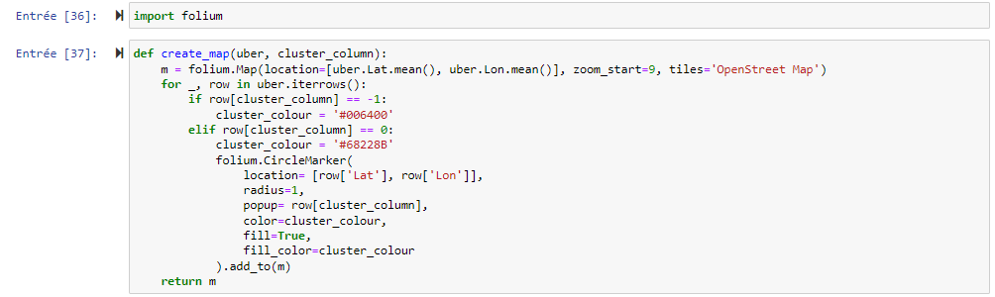
Map

Slide 9
Thank you !
Trello link :
https://trello.com/b/mOVAzv27/group5project8

